Slide 1



Slide 2
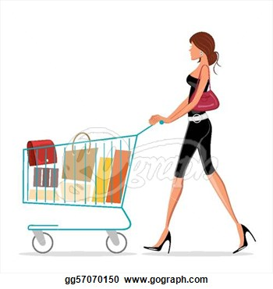
Why?

Slide 3


When?

Slide 4
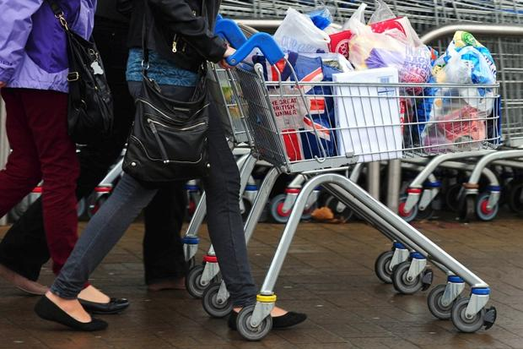
The Idea
Follow me Trolley

Slide 5
1. Shopper tells his location to the trolley ☺ 2. Trolley moves in that direction 3. Trolley stops whenever shopper stops or an obstacle arrives
How?

Slide 6
Take one ultrasonic sound transmitter and a couple of receiver those work on a particular frequency (within the ultrasonic range*). Transmit and try to receive in all(both) receivers. Deduce shortest distance between transmitter and receiver. We know the required direction of trolley’s movement. Take another ultrasonic proximity sensor and integrate it for obstacle avoidance. * - 35KHz to 45 KHz
How? (Behind the scene)

Slide 7
List of failures
Sounds Easy, eh?
Wifi Module | ESP-01 (ESP 8266) | Command works. Doesn’t work from code
GPS | NEO6MV2 | Doesn’t work inside store
Ultrasound generic sensor | SR04 | No separate receive or transmit feature
Bluetooth | HC-05 | Delay in receiving
------------------------------ |  | Almost quit

Slide 8
There’s More?? ☺

Slide 9


Slide 10
1. Shopper dumps product in trolley 2. Product gets added to customer’s cart. 3. No checkout queue. 4. Customer arrives at self payment kiosk. 5. Shopping Done!!!
Auto checkout of Products

Slide 11
Q & A

